Slide 1
Web Scraping to Gain Company Insights
British Airways Data

Slide 2
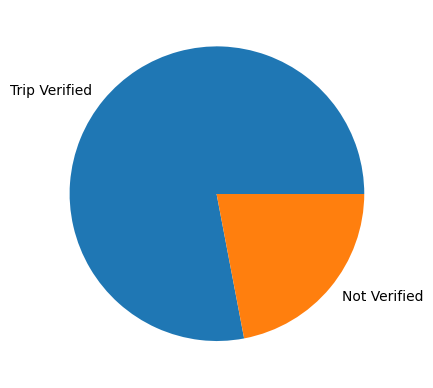
Distribution of Number of Reviews Verified and Unverified Trips

Slide 3
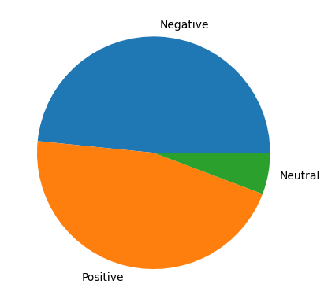
Sentiments of Reviews for Unverified Trips

Slide 4
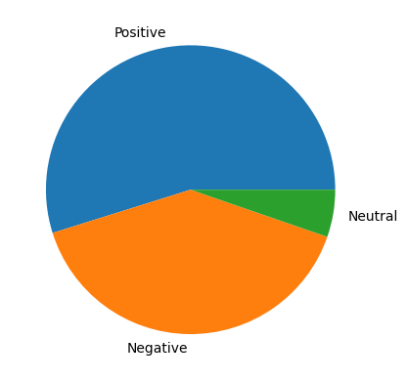
Sentiments of Reviews of Verified Trips

Slide 5
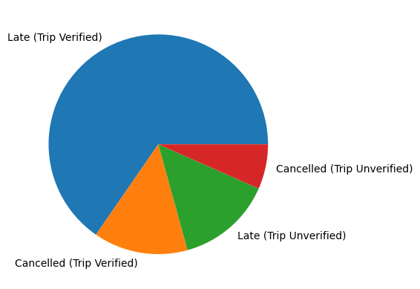
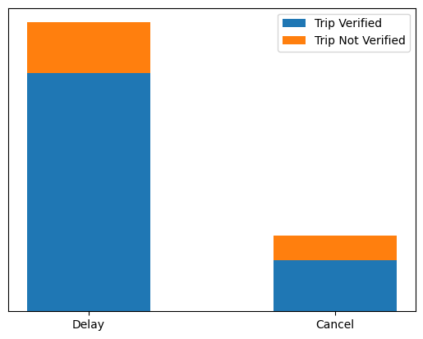
Analysis of Relative Number of Reviews on Delayed and Cancelled Flights

Slide 6
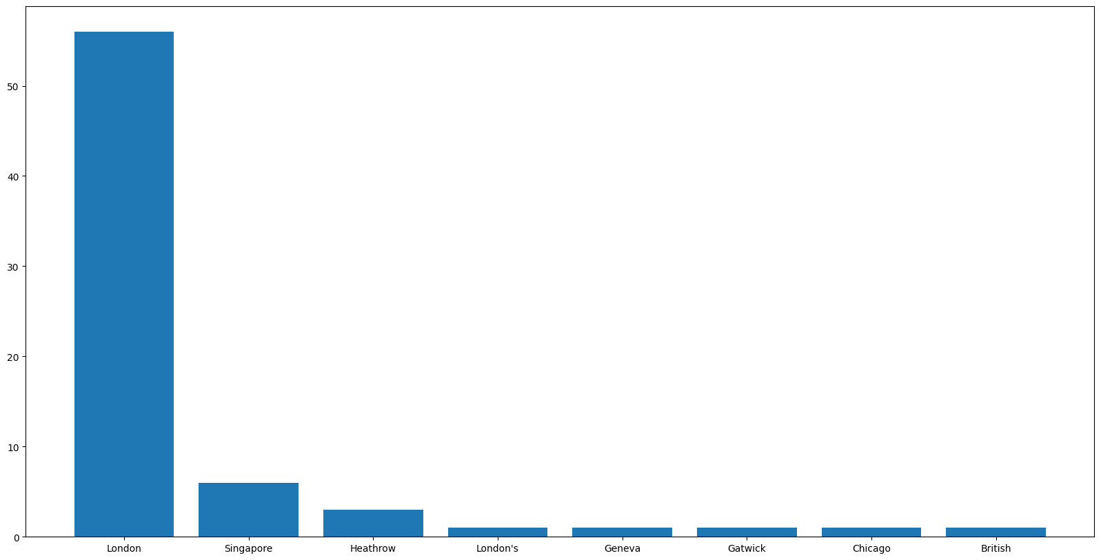
Major Stops for Connecting Flights of Reviewers

Slide 7
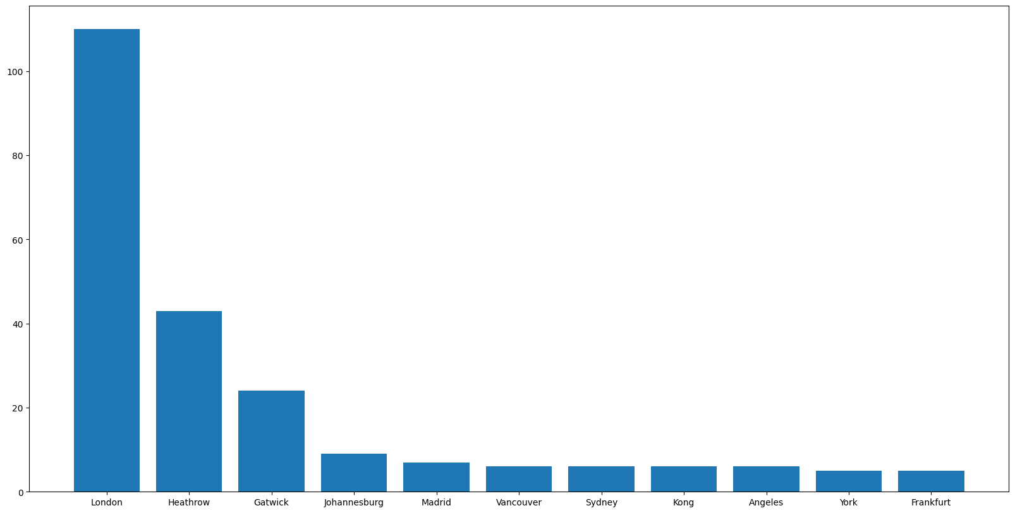
Major Source Airports of the Reviewers

Slide 8
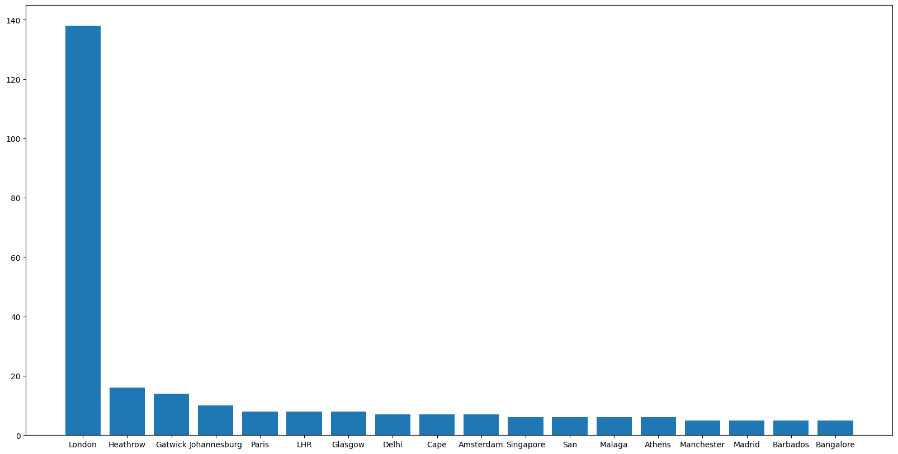
Major Destination Airports of the Reviewers

Slide 9
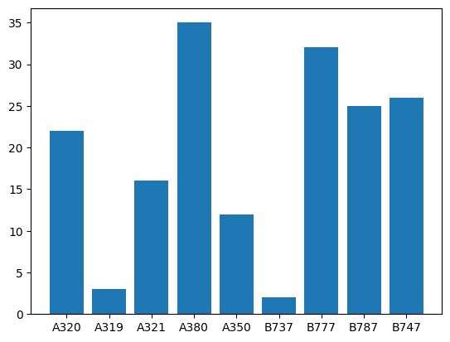
Types of Aircrafts used for Travelling by the Reviewers

Slide 10
Major Insights and Conclusions
Most of the trips are verified.
About half of the unverified trips have a negative sentiment.
More than half of the verified trips have a positive sentiment.
There are more delays than cancellations and most of these delays and cancellations are claimed by verified reviewers.
The major stations where the connecting flights stop are analysed. They may cause a delay in the journey.
The major sources and destinations as displayed in previous slides may also contribute to major delays and cancellations.
Most of the aircrafts used by the reviewers are B777 and A380.

